Slide 1
Web Application attacks & prevention & protection against vulnerabilities
PRESENTED BY:
T. SAI TEJA

Slide 2
OBJECTIVES
INTRODUCTION
LITERATURE REVIEW
METHODOLOGY
WEB APPLICATION ATTACKS
OWASP
RESULTS
CONCLUSION
REFERENCES

Slide 3
INTRODUCTION
Web application is a software that users can access through their web browser. It is developed in simple languages such as CSS, JavaScript, and HTML, supported by browsers.
Web application security refers to a variety of processes, technologies, or methods for protecting web servers, web applications, and web services such as APIs from attack by Internet-based threats.
It is crucial to protecting data, customers, and organizations from data theft, interruptions in business continuity, or other harmful results of cybercrime.

Slide 4
LITERATURE REVIEW
Since the development of the internet and world wide web(WWW), web application have become very popular. [1]
Web applications are used to perform numerous functions, from online shopping to banking transactions. [3]
Increasing the use of web applications, has also increased the raise of web application attacks [2]
These attacks can result in severe consequences for both the organization and the users of the web application. [4]
It is essential to understand the types of web application attacks and their impacts. [5]

Slide 5
METHODOLOGY
Attackers perform attacks using a detailed process called hacking methodology to gain knowledge of a particular web application to compromise it successfully.
This methodology allows them to plan each step in detail to increase their chances of successfully hacking the application.
To collect information about various resources needed to run or access the web application, one of the methodologies are
Footprinting web application is the process of gathering information about the application and its underlying infrastructure. This information can be used to identify potential vulnerabilities and weaknesses that could be exploited by attackers.

Slide 6
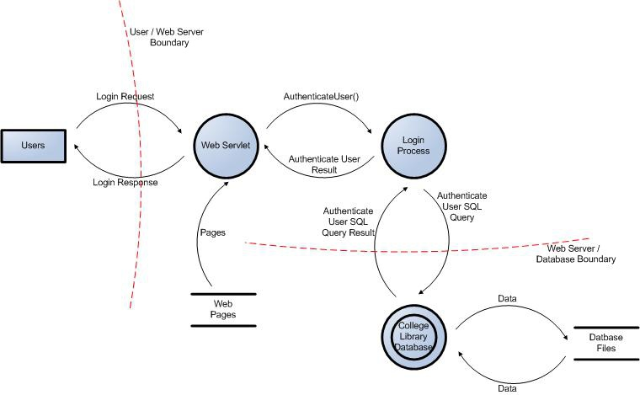
METHODOLOGY

Slide 7
WEB APPLICATION ATTACKS
Vulnerability: A vulnerability is a weakness that can be exploited by cybercriminals to gain unauthorized access to a computer system. After exploiting a vulnerability, a cyberattack can run malicious code, install malware, and even steal sensitive data.
Web application attacks: A web application attack is any attempt to exploit vulnerabilities on either side, client or server, of that process in order to access sensitive information, perform unauthorized action, or disrupt the normal functioning of the application.

Slide 8
OWASP (Open Web Application Security Project)
The OWASP is a nonprofit foundation that works to improve the security of software. It publishes the top ten security vulnerabilities. It represents a broad consensus about the most critical security risks to web applications. The most common web application security risks are:
Broken Access Control
Cryptographic Failure
Injection
Insecure Design
Security Misconfiguration

Slide 9
RESULTS
We have practically implemented these 4 attacks:
SQL Injection
DOS Attack
DDOS Attack
XSS Attack

Slide 10
SQL Injection
SQL injection(SQLi) is a web security vulnerability that allows an attacker to interfere with the queries that an application makes to its database.
It allows an attacker to view data that they are not normally able to retrieve.
It includes data belonging to other users, or any other data that the application itself is able to access.

Slide 11
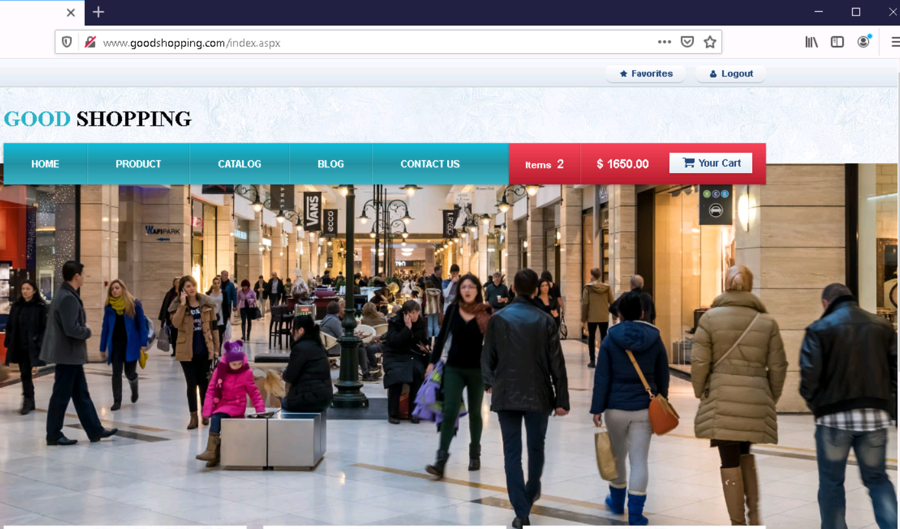
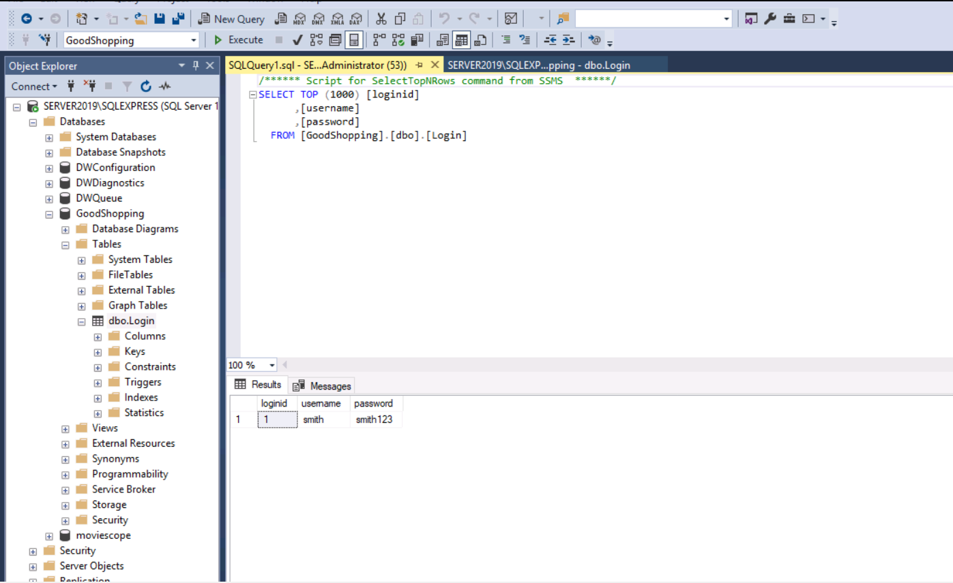
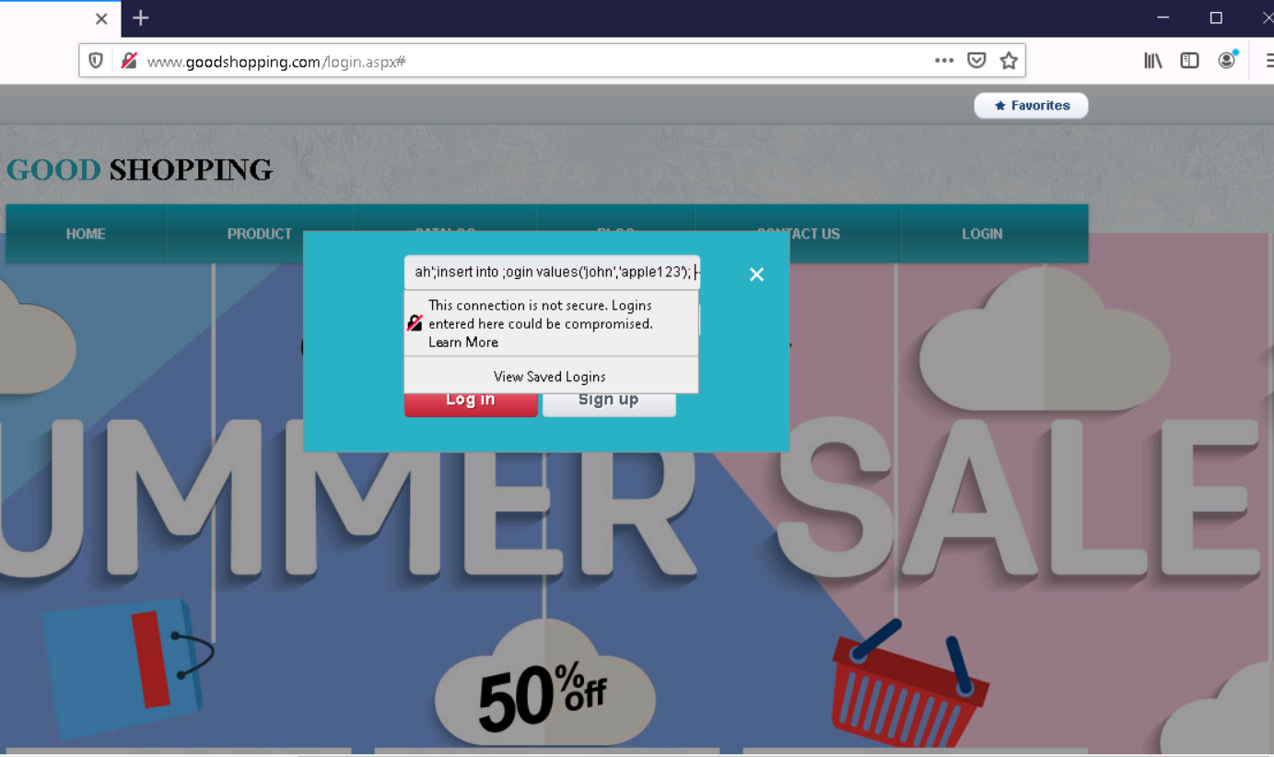
SQL INJECTION ATTACK

Slide 12
PREVETION METHODS
Use parameterized queries
Sanitize user inputs
Limit database privileges
Use an application firewall
Keep software up-to-date
Use least privilege principle

Slide 13
DOS Attack
A Denial of Service (DoS) attack is a cyber attack in which the attacker attempts to disrupt the normal functioning of a website by overwhelming it with traffic.
They are several types of DoS attacks:
Smurf Attack: An attacker sends ICMP echo requests to the broadcast address of a network, causing all devices on the network to respond to the request and flooding the target system with traffic
SYN Attack: Attacker sends SYN(synchronize) requests to the target system, but never completes the hand shake, which ties upon resources and makes the system unresponsive.

Slide 14
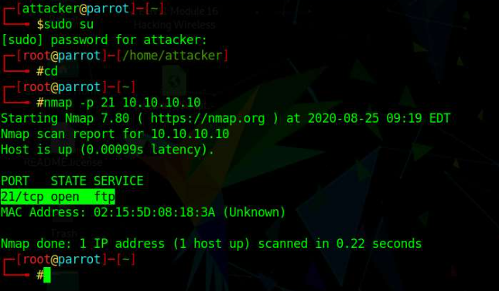
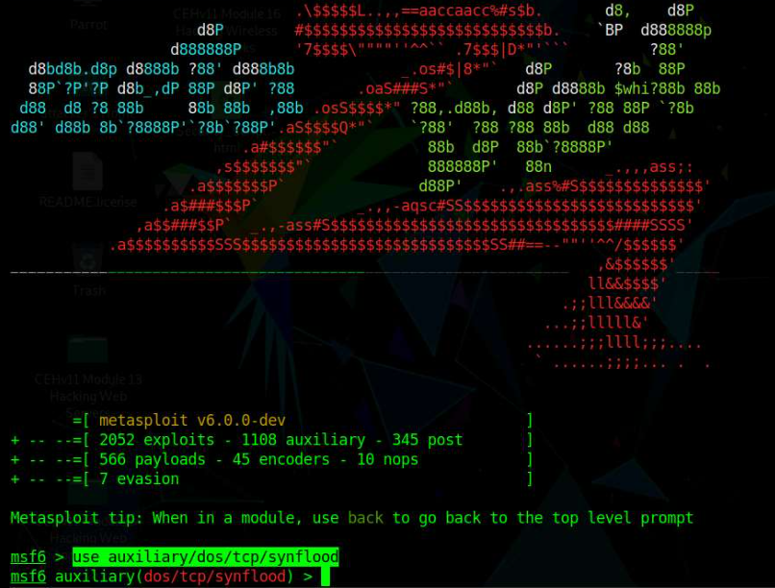
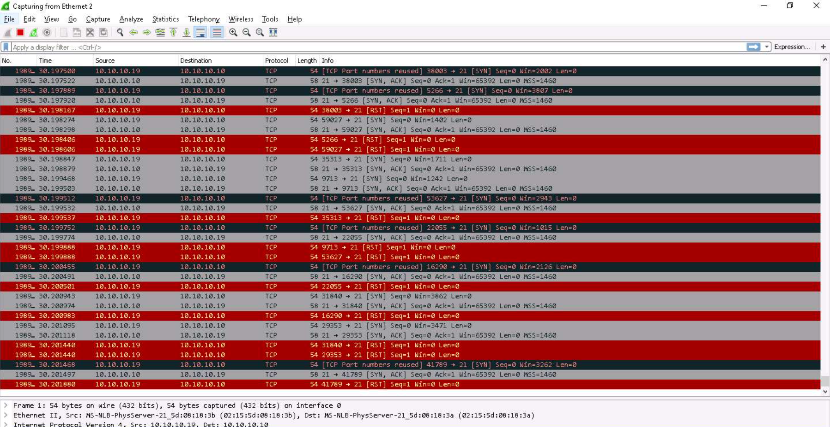
DoS Attack

Slide 15
PREVENTIONS OF DOS ATTACK
Keep your software up-to-date
Use firewalls
Limit resources usage of a user
Use content delivery network
Monitor network traffic
Educate your users

Slide 16
DDoS Attack
A DDoS (Distributed Denial of Service) attack is a type of cyber-attack that aims to disrupt the normal functioning of a target system, network, or website by overwhelming it with traffic from multiple sources.
Attacker uses a network of compromised computers to flood the target with traffic, making it unavailable to users.

Slide 17
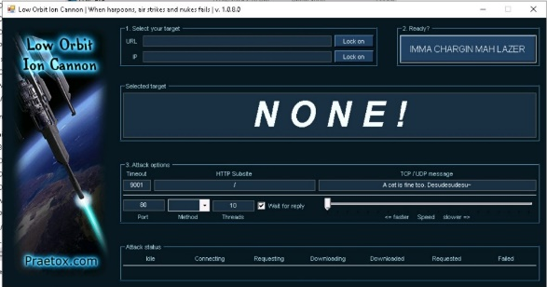
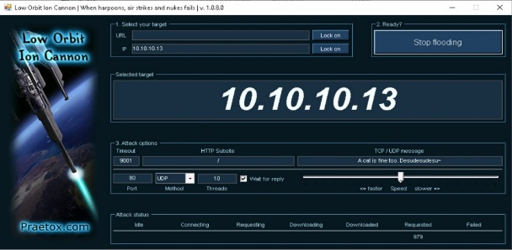
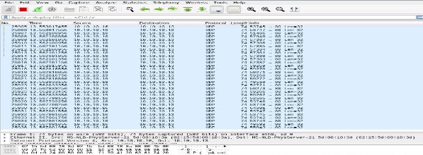
DDoS Attack

Slide 18
PREVENTION OF DDoS ATTACKS
Use DDoS mitigation services: which blocks malicious traffic before it reaches your network.
Monitor network traffic
Implementing access control
Keep software up-to-date
Use load balancers
Develop an incident response plan

Slide 19
XSS Attack
XSS (Cross-Site Scripting) is a type of web vulnerability that allows attackers to inject malicious scripts into web pages viewed by other users.
XSS attack is to execute a malicious script in the victim’s browser, stealing sensitive information, performing unauthorized actions, or spreading malware.
XSS attacks are of three types
Reflected XSS
Stored XSS
DOM-based XSS

Slide 20
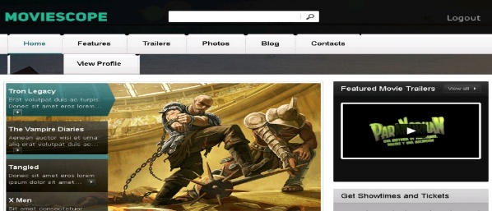
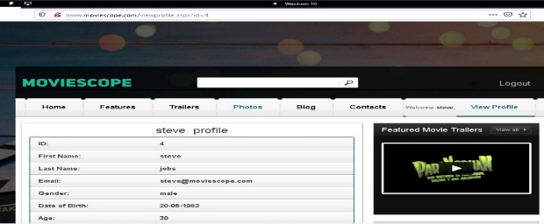
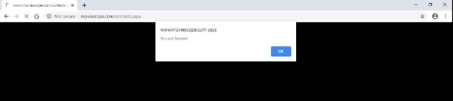
XSS ATTACK

Slide 21
PREVENTION OF XSS ATTACK
Input validation
Output encoding
Use HTTPS
Keep your software up-to-date
Use a content security Policy
Educate users

Slide 22
CONCLUSION
In this, we performed an SQL injection attack, DoS attack, DDoS attack, and XSS (Cross-Site Scripting) attack.
Web applications are more at now than before, so executives must take the proper steps to secure their web applications. Leveraging technology and innovative methodologies can go a long way toward minimizing the effects of even the most dangerous cyber-attacks.
We also discussed the countermeasures regarding web application attacks like Broken conformation, validation, sensitive information exposure, XML External Entity, and Broken Access Control.

Slide 23
Future Scope
As web technology continues to evolve, so do the methods and technologies used by attackers to exploit vulnerabilities in web application.
Some possible future trends in web application attacks are
API Attacks: As more and more applications rely on APIs to communicate with each other, attackers may target these interfaces to gain unauthorized access to sensitive data or system
Cloud-Based attacks: As more organizations migrate their web applications to the cloud, attackers may target these cloud-based environments in order to gain access to sensitive data or systems.

Slide 24
REFERENCES
T. G. Author, “Common Web application attacks,” 2020. https://www.tripwire.com/state-of-security/most-common-website-security-attacks-and-how-to-protect-yourself
https://itbrief.com.au/story/malicious-web-application-attacks-climb-88-report#:~:text=The report findings 2017
https://owasp.org/www-project-top-ten/#
https://brightsec.com/blog/web-application-vulnerabilities/#:~:text=Common Types of Web Application Vulnerabilities,-1.&text=SQL vulnerabilities allow attackers to,by web applications or services. 2019
https://www.britannica.com/technology/operating-system
https://www.acunetix.com/websitesecurity/web-application-attack/
https://portswigger.net/web-security/sql-injection/union-attacks

Slide 25
Thank you

